Slide 1
WEB AUTHORING: DW, PHP, MYSQL
SESSION 04 – FORM AND FRAME

Slide 2
OBJECTIVES
Using form to collect information
Form elements
Using frame to split pages

Slide 3
Introduction to Form
HTML forms are used to pass data to a server.
Collecting names, addresses, telephone numbers, e-mail addresses, and other information to register users for a service or event
A form can contain input elements like text fields, checkboxes, radio-buttons, submit buttons and more. A form can also contain select lists, textarea, fieldset, legend, and label elements.

Slide 4
Using form
<FORM>form</FORM>: creates a form which is used to request and gather information from a web site visitor.
Forms cannot be nested inside of other forms.
<FORM> tag must contain attributes:
METHOD="POST | GET": states that the method of dealing with the completed information in the form is to post it.
ACTION=“address": indicates that the completed information is to be supplied or mailed to your email address

Slide 5
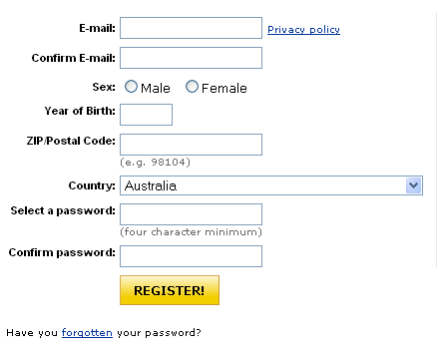
A sample form

Slide 6
The Input Element
The most important form element is the input element.
The input element is used to select user information.
An input element can vary in many ways, depending on the type attribute. An input element can be of type text field, checkbox, password, radio button, submit button, and more.

Slide 7
The Input Element
<INPUT>: indicates that a certain type of form element
The INPUT element attribute:
TYPE
NAME
VALUE
SIZE
MAXLENGTH
CHECKED
SRC……

Slide 8
Input –Type Attribute
Text
Password
Hidden
Checkbox
Radio
Submit
Image
Button
Reset
File

Slide 9
Code sample form
<form name="input" action="html_form_action.asp" method="get">
First name: <input type="text" name="firstname" /><br />
Password: <input type="password" name="pwd" /><br />
Gender: <input type="radio" name="sex" value="male" /> Male
<input type="radio" name="sex" value="female" /> Female<br />
<input type="checkbox" name="vehicle" value="Bike" /> I have a bike<br />
<input type="checkbox" name="vehicle" value="Car" /> I have a car
<br /><br />
<input type="submit" value="Submit" />
</form>

Slide 10
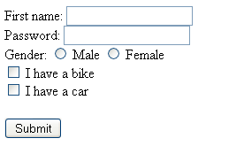
Output

Slide 11
SELECT element
<SELECT><OPTION>tags</OPTION></SELECT>: creates a pop-up box.
The <SELECT> tag contains within it other parameters as part of the command:
NAME="name": designates a name for the pop-up box, such as "Modem speed" or "Pets owned" or whatever.
MULTIPLE: indicates that more than one item in the box can be selected

Slide 12
TEXTAREA element
<TEXTAREA>(optional text)</TEXTAREA>: creates a box in which information may be typed with multi rows
<TEXTAREA> tag should contain within it other parameters as part of the command:
NAME="name": assigns a name to the text area box
ROWS="R": defines the number of rows (lines) “R” of text that are visible in the text box.
COLS="C": defines the number of characters “C” that can be typed in each row (line) of text before a new line is begun.

Slide 13
Sample select element
<FORM> <SELECT NAME="Computer" MULTIPLE SIZE="4"> <OPTION SELECTED>250 MHz or faster <OPTION>4.0 GB or larger hard drive <OPTION SELECTED>floppy disc drive <OPTION>10X or faster CD ROM drive <OPTION>active matrix screen </SELECT></FORM>

Slide 14

Output

Slide 15
Forms
Controlling the elements
Setting focus
Tab order
Access keys
Disabling Elements

Slide 16
HTML Frames
With frames, you can display more than one HTML document in the same browser window.
Each HTML document is called a frame, and each frame is independent of the others.
The disadvantages of using frames are:
The web developer must keep track of more HTML documents
It is difficult to print the entire page

Slide 17
The HTML frameset Element
The frameset element holds two or more frame elements. Each frame element holds a separate document.
The frameset element states only HOW MANY columns or rows there will be in the frameset.
<FRAMESET >frameset, frame, or noframe tags</FRAMESET>

Slide 18
Frameset attributes
ROWS="H,H,...“
COLS="W,W,...”
FRAMEBORDER="YES"|"NO“
BORDER="B“
BORDERCOLOR="COLOR"|"#COLOR CODE"

Slide 19
Frame
<FRAME>: defines a single frame in a frameset. This frame will be part of a row or a column, as designated in the <FRAMESET> tag before it
Attributes:
SRC="URL”
NAME="frame name“
SCROLLING="YES"|"NO"|"AUTO“
NORESIZE
FRAMEBORDER="YES"|"NO"

Slide 20
Sample
<frameset rows="*,80" cols="*" frameborder="yes" border="1" framespacing="0">
<frameset cols="80,*" frameborder="yes" border="1" framespacing="0">
<frame src="test01.html" name="leftFrame" scrolling="No" noresize="noresize" id="leftFrame" title="leftFrame">
<frame src="test02.html" name="mainFrame" id="mainFrame" title="mainFrame">
</frameset>
<frame src="test03.html" name="bottomFrame" scrolling="No" noresize="noresize" id="bottomFrame" title="bottomFrame">
</frameset>

Slide 21
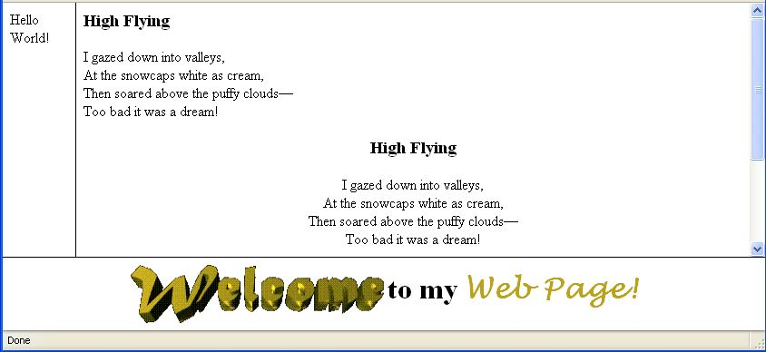
Output

Slide 22
Other frame elements
<NOFRAMES>message</NOFRAMES>: provides alternate text or information, for a browser which does not support frames
<iframe src=“path“ width=“number” height=“number”></iframe>

Slide 23
Summary
<FORM>form</FORM>: creates a form
<INPUT>: indicates that a certain type of form element
<SELECT><OPTION>tags</OPTION></SELECT>: creates a pop-up box.
<TEXTAREA>(optional text)</TEXTAREA>: creates a box
The disadvantages of using frames are:
The web developer must keep track of more HTML documents
It is difficult to print the entire page

